Slide 1
Decision Tree using CART algorithm
The ability of decision tree algorithms to make transparent decisions continues to maintain their appeal.
For splitting, ID3 employs information gain whereas C4.5 utilizes gain ratio.
CART is a different algorithm for creating decision trees in this case.
Both classification and regression problems are manageable.
This technique generates decision points for classification tasks by using a novel statistic called the Gini index.

Slide 2
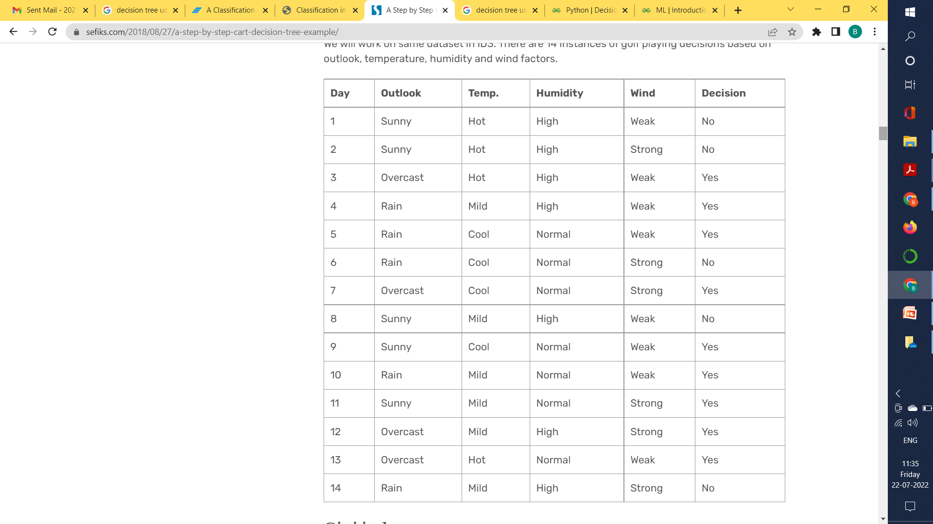
Step-by-Step CART decision tree example

Slide 3
Gini index
Gini index is a metric for classification tasks in CART. It stores sum of squared probabilities of each class. We can formulate it as illustrated below.
Gini = 1 – Σ (Pi)² for i=1 to number of classes
Outlook is a nominal feature. It can be sunny, overcast or rain.
Gini(Outlook=Sunny) = 1 – (2/5)² – (3/5)² = 1 – 0.16 – 0.36 = 0.48
Gini(Outlook=Overcast) = 1 – (4/4)² – (0/4)² = 0
Gini(Outlook=Rain) = 1 – (3/5)² – (2/5)² = 1 – 0.36 – 0.16 = 0.48
Then, calculate weighted sum of gini indexes for outlook feature.
Gini(Outlook) = (5/14) x 0.48 + (4/14) x 0 + (5/14) x 0.48
= 0.171 + 0 + 0.171 = 0.342
Outlook | Yes | No | No. of entries
Sunny | 2 | 3 | 5
Overcast | 4 | 0 | 4
Rainy | 3 | 2 | 5

Slide 4
Temperature is also nominal feature. It can be cool, hot or mild.
Gini(Temp=Hot) = 1 – (2/4)² – (2/4)² = 0.5
Gini(Temp=Cool) = 1 – (3/4)² – (1/4)² = 1 – 0.5625 – 0.0625 = 0.375
Gini(Temp=Mild) = 1 – (4/6)² – (2/6)² = 1 – 0.444 – 0.111 = 0.445
Then, calculate weighted sum of gini index for temperature feature
Gini(Temp) = (4/14) x 0.5 + (4/14) x 0.375 + (6/14) x 0.445
= 0.142 + 0.107 + 0.190 = 0.439
Temperature | Yes | No | No. of entries
Cool | 3 | 1 | 4
Hot | 2 | 2 | 4
Mild | 4 | 2 | 6

Slide 5
Humidity is a binary class feature. It can be high or normal.
Gini(Humidity=High) = 1 – (3/7)² – (4/7)² = 1 – 0.183 – 0.326 = 0.489
Gini(Humidity=Normal) = 1 – (6/7)² – (1/7)² = 1 – 0.734 – 0.02 = 0.244
Then, calculate weighted sum of gini index for humidity feature
Gini(Humidity) = (7/14) x 0.489 + (7/14) x 0.244 = 0.367
Wind is also binary class feature. It can be weak or strong.
Gini(Wind=Weak) = 1 – (6/8)² – (2/8)² = 1 – 0.5625 – 0.062 = 0.375
Gini(Wind=Strong) = 1 – (3/6)² – (3/6)² = 1 – 0.25 – 0.25 = 0.5
Gini(Wind) = (8/14) x 0.375 + (6/14) x 0.5 = 0.428
Humidity | Yes | No | No. of entries
High | 3 | 4 | 7
Normal | 6 | 1 | 7
Wind | Yes | No | No. of entries
Weak | 6 | 2 | 8
Strong | 3 | 3 | 6

Slide 6
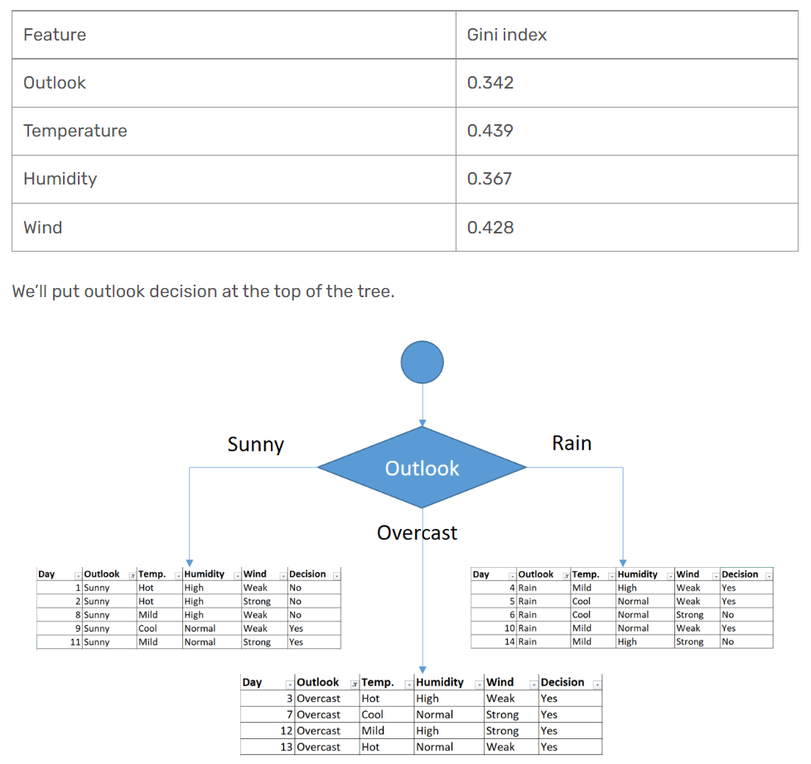

Slide 7
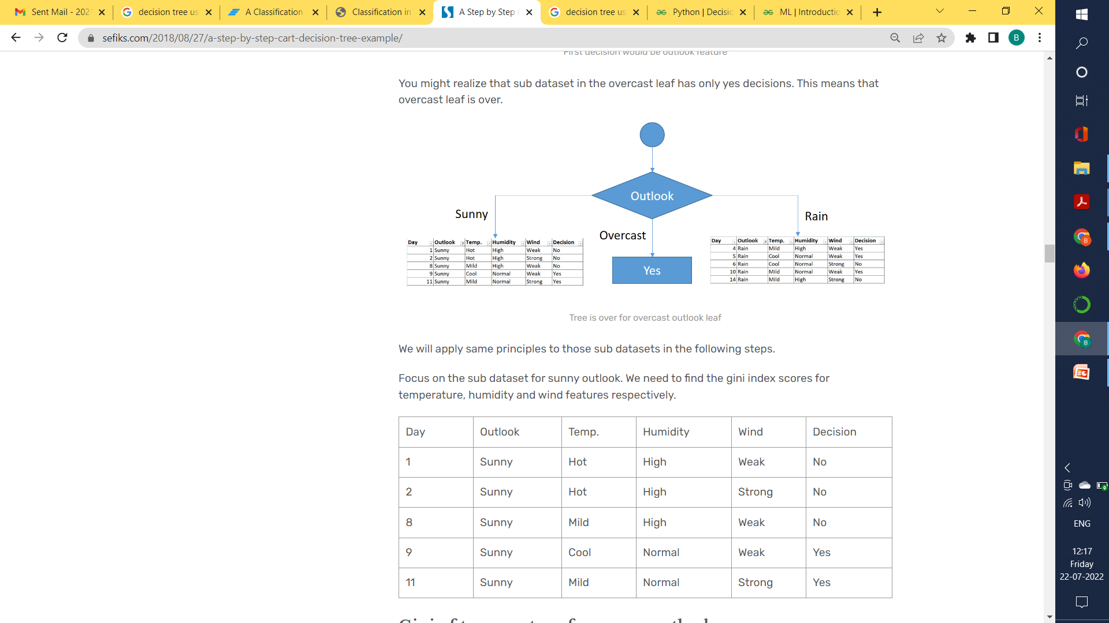

Slide 8
Gini of Temperature for Sunny Outlook
Gini(Outlook=Sunny and Temp.=Hot) = 1 – (0/2)² – (2/2)² = 0
Gini(Outlook=Sunny and Temp.=Cool) = 1 – (1/1)² – (0/1)² = 0
Gini(Outlook=Sunny and Temp.=Mild) = 1 – (1/2)² – (1/2)²
= 1 – 0.25 – 0.25 = 0.5
Gini(Outlook=Sunny and Temp.) = (2/5)x0 + (1/5)x0 + (2/5)x0.5 = 0.2

Slide 9
Gini of Humidity for Sunny Outlook
Gini(Outlook=Sunny and Humidity=High) = 1 – (0/3)² – (3/3)² = 0
Gini(Outlook=Sunny and Humidity=Normal) = 1 – (2/2)² – (0/2)² = 0
Gini(Outlook=Sunny and Humidity) = (3/5)x0 + (2/5)x0 = 0
Gini of Wind for Sunny Outlook
Gini(Outlook=Sunny and Wind=Weak) = 1 – (1/3)² – (2/3)² = 0.266
Gini(Outlook=Sunny and Wind=Strong) = 1- (1/2)² – (1/2)² = 0.2
Gini(Outlook=Sunny and Wind) = (3/5)x0.266 + (2/5)x0.2 = 0.466
Decision for Sunny Outlook
The winner is humidity feature for sunny outlook because it has the minimum gini index score in features.
Feature | Gini Index
Temperature | 0.2
Humidity | 0
Wind | 0.466

Slide 10
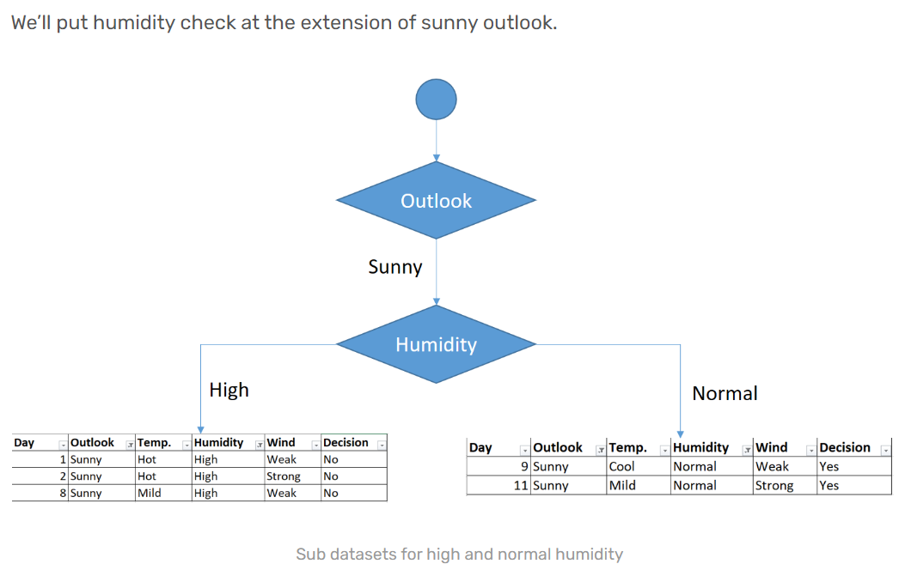

Slide 11
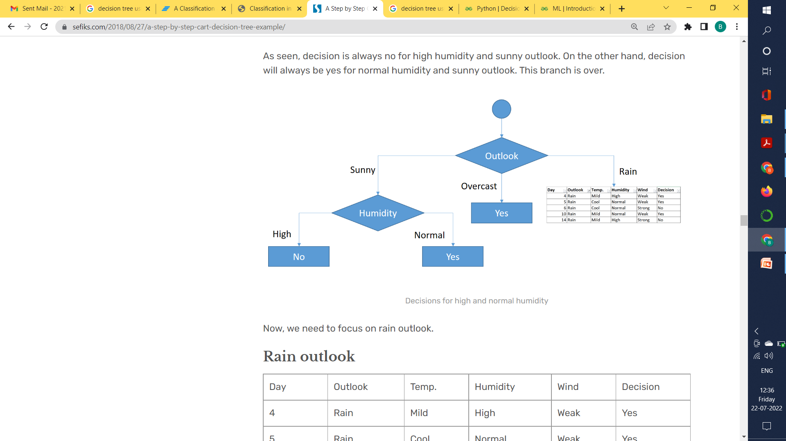

Slide 12
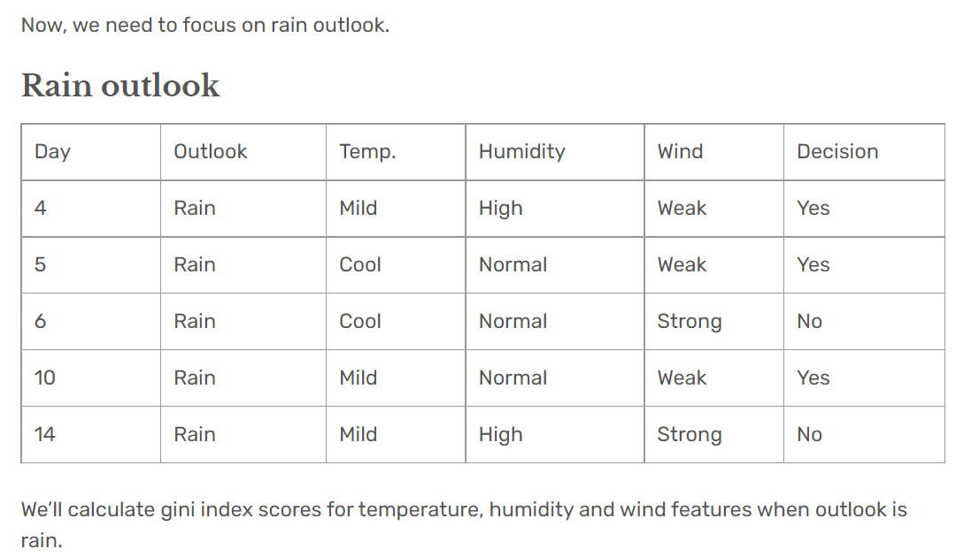
Gini of Temprature for Rain Outlook
Gini(Outlook=Rain and Temp.=Cool) = 1 – (1/2)² – (1/2)² = 0.5
Gini(Outlook=Rain and Temp.=Mild) = 1 – (2/3)² – (1/3)² = 0.444
Gini(Outlook=Rain and Temp.) = (2/5)x0.5 + (3/5)x0.444 = 0.466

Slide 13
Gini of Humidity for Rain Outlook
Gini(Outlook=Rain and Humidity=High) = 1 – (1/2)² – (1/2)² = 0.5
Gini(Outlook=Rain and Humidity=Normal) = 1 – (2/3)² – (1/3)² = 0.444
Gini(Outlook=Rain and Humidity) = (2/5)x0.5 + (3/5)x0.444 = 0.466
Gini of Wind for Rain Outlook
Gini(Outlook=Rain and Wind=Weak) = 1 – (3/3)² – (0/3)² = 0
Gini(Outlook=Rain and Wind=Strong) = 1 – (0/2)² – (2/2)² = 0
Gini(Outlook=Rain and Wind) = (3/5)x0 + (2/5)x0 = 0
Decision for Rain Outlook
calculated gini index scores for feature when outlook is rain. The winner is wind because it has the lowest value.
Features | Gini Index
Temperature | 0.466
Humidity | 0.466
Wind | 0

Slide 14
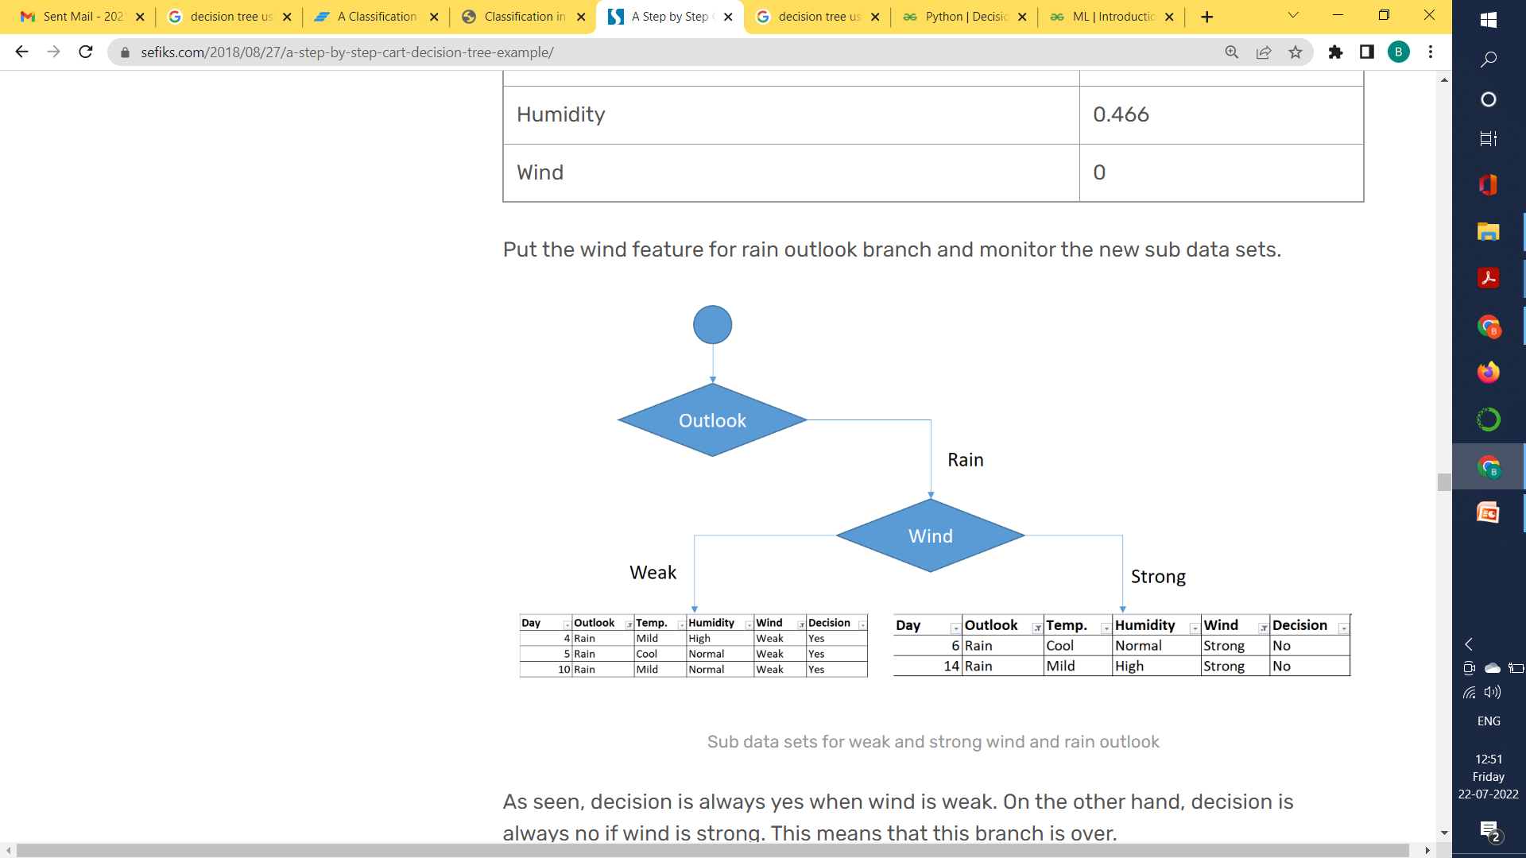

Slide 15
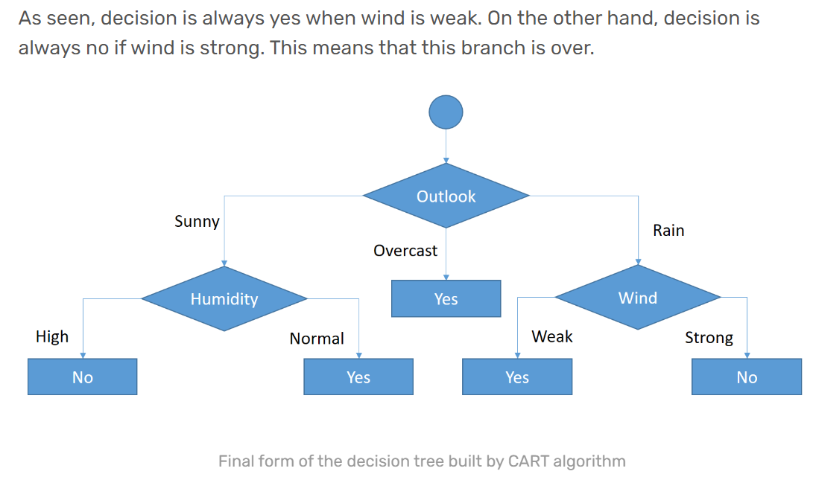
When ID3 and CART algorithms are applied on same dataset it does not mean that they both will produce same trees always .

